Slide 1
Time Clauses
Basic 11 – Unit 7b

Slide 2
Use an adverb clause to show time relationships.
when = at that time
People say Happy New Year! when the clock says it is midnight (12am).
When do people say Happy New Year!?
The moment the clock says it is midnight

Slide 3
Use an adverb clause to show time relationships.
after = to introduce the action that
happens first
1
2
After I get up, I take a shower.
What do I do after I get up?
I take a shower

Slide 4
Use an adverb clause to show time relationships.
after = to introduce the action that
happens first
1
2
Before I cook, I check to see if I have all the ingredients.
What do I do before I cook?
I check to see if I have all the ingredients

Slide 5
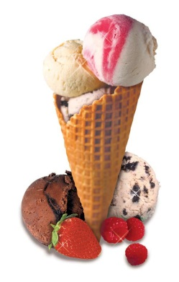
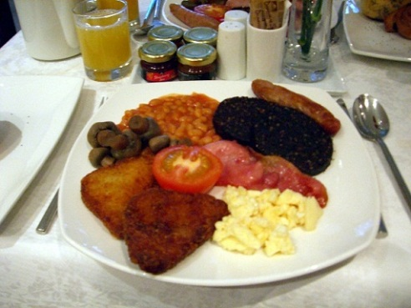
Time Clauses
Use the before to talk about an event that happens first.
My sister eats ice cream. . .
. . . before she has dinner.
7pm
9pm
She eats ice cream
She has dinner

Slide 6

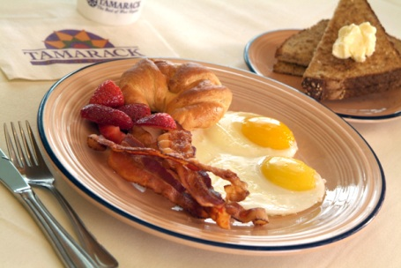
Time Clauses
Use the after to talk about an event that happens second.
My mom drinks a cup of coffee. . .
. . . after she eats dinner.
7pm
9pm
She eats dinner
She has a cup of coffee

Slide 7

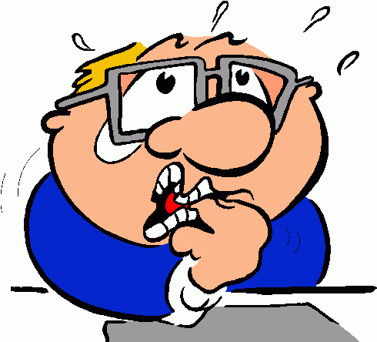
Time Clauses
Use the when to talk about an event that happens at the same time or immediately after another.
When carlos is stressed. . .
. . . he bites his nails.
11pm
11pm
Carlos is stressed
He bites his nails

